Slide 1
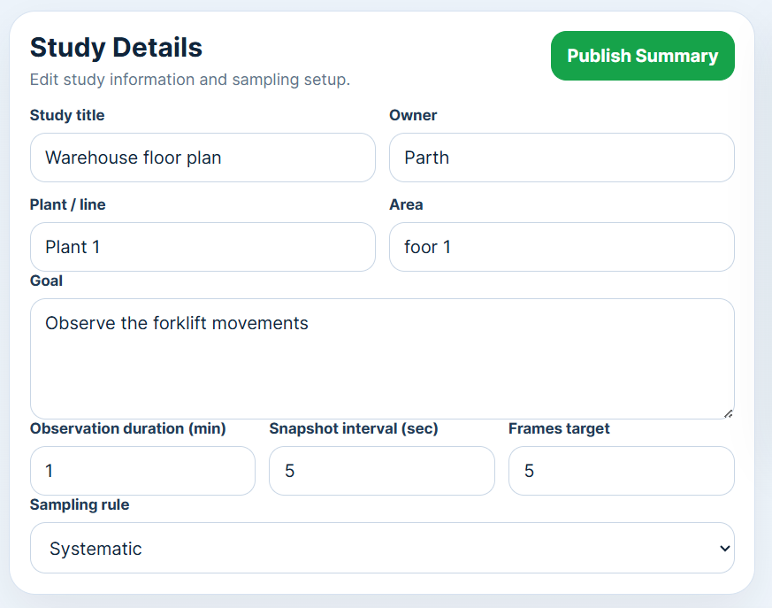

Study Information
Upload Media
Process Step
Observed Problems
Next

Slide 2
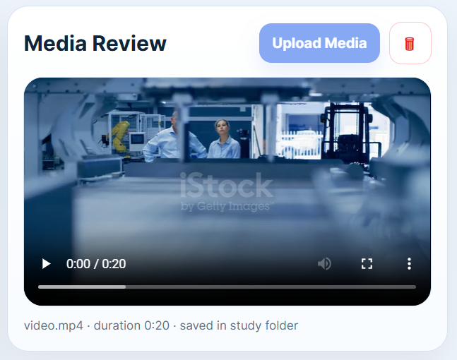
Study Information
Upload Media
Process Step
Observed Problems
Next

Slide 3
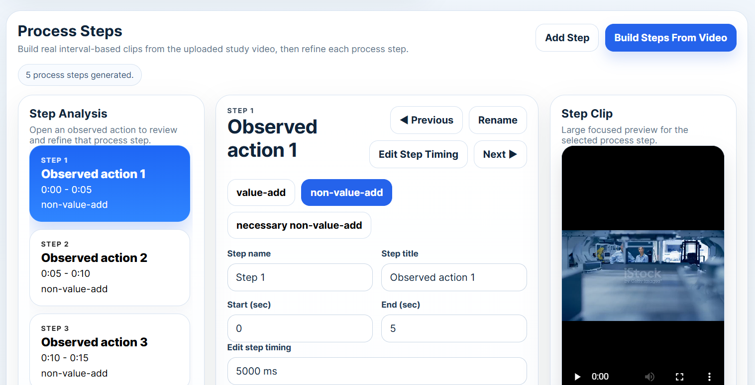




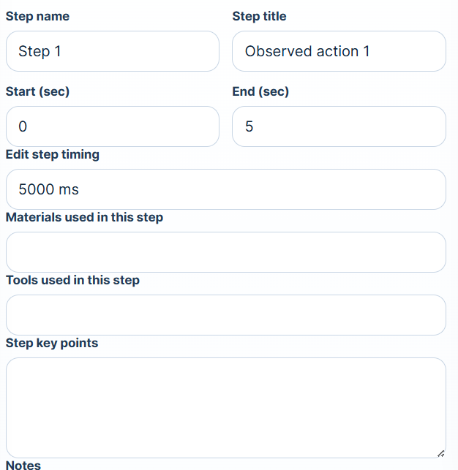
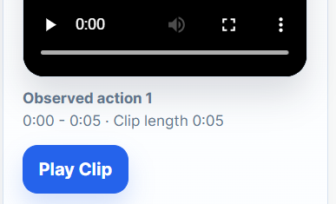

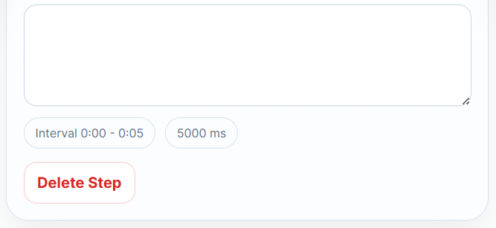
Study Information
Upload Media
Process Step
Observed Problems
Next

Slide 4
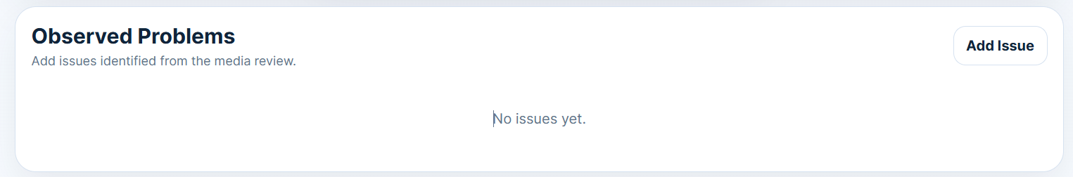

Study Information
Upload Media
Process Step
Observed Problems
Submit

